Slide 1

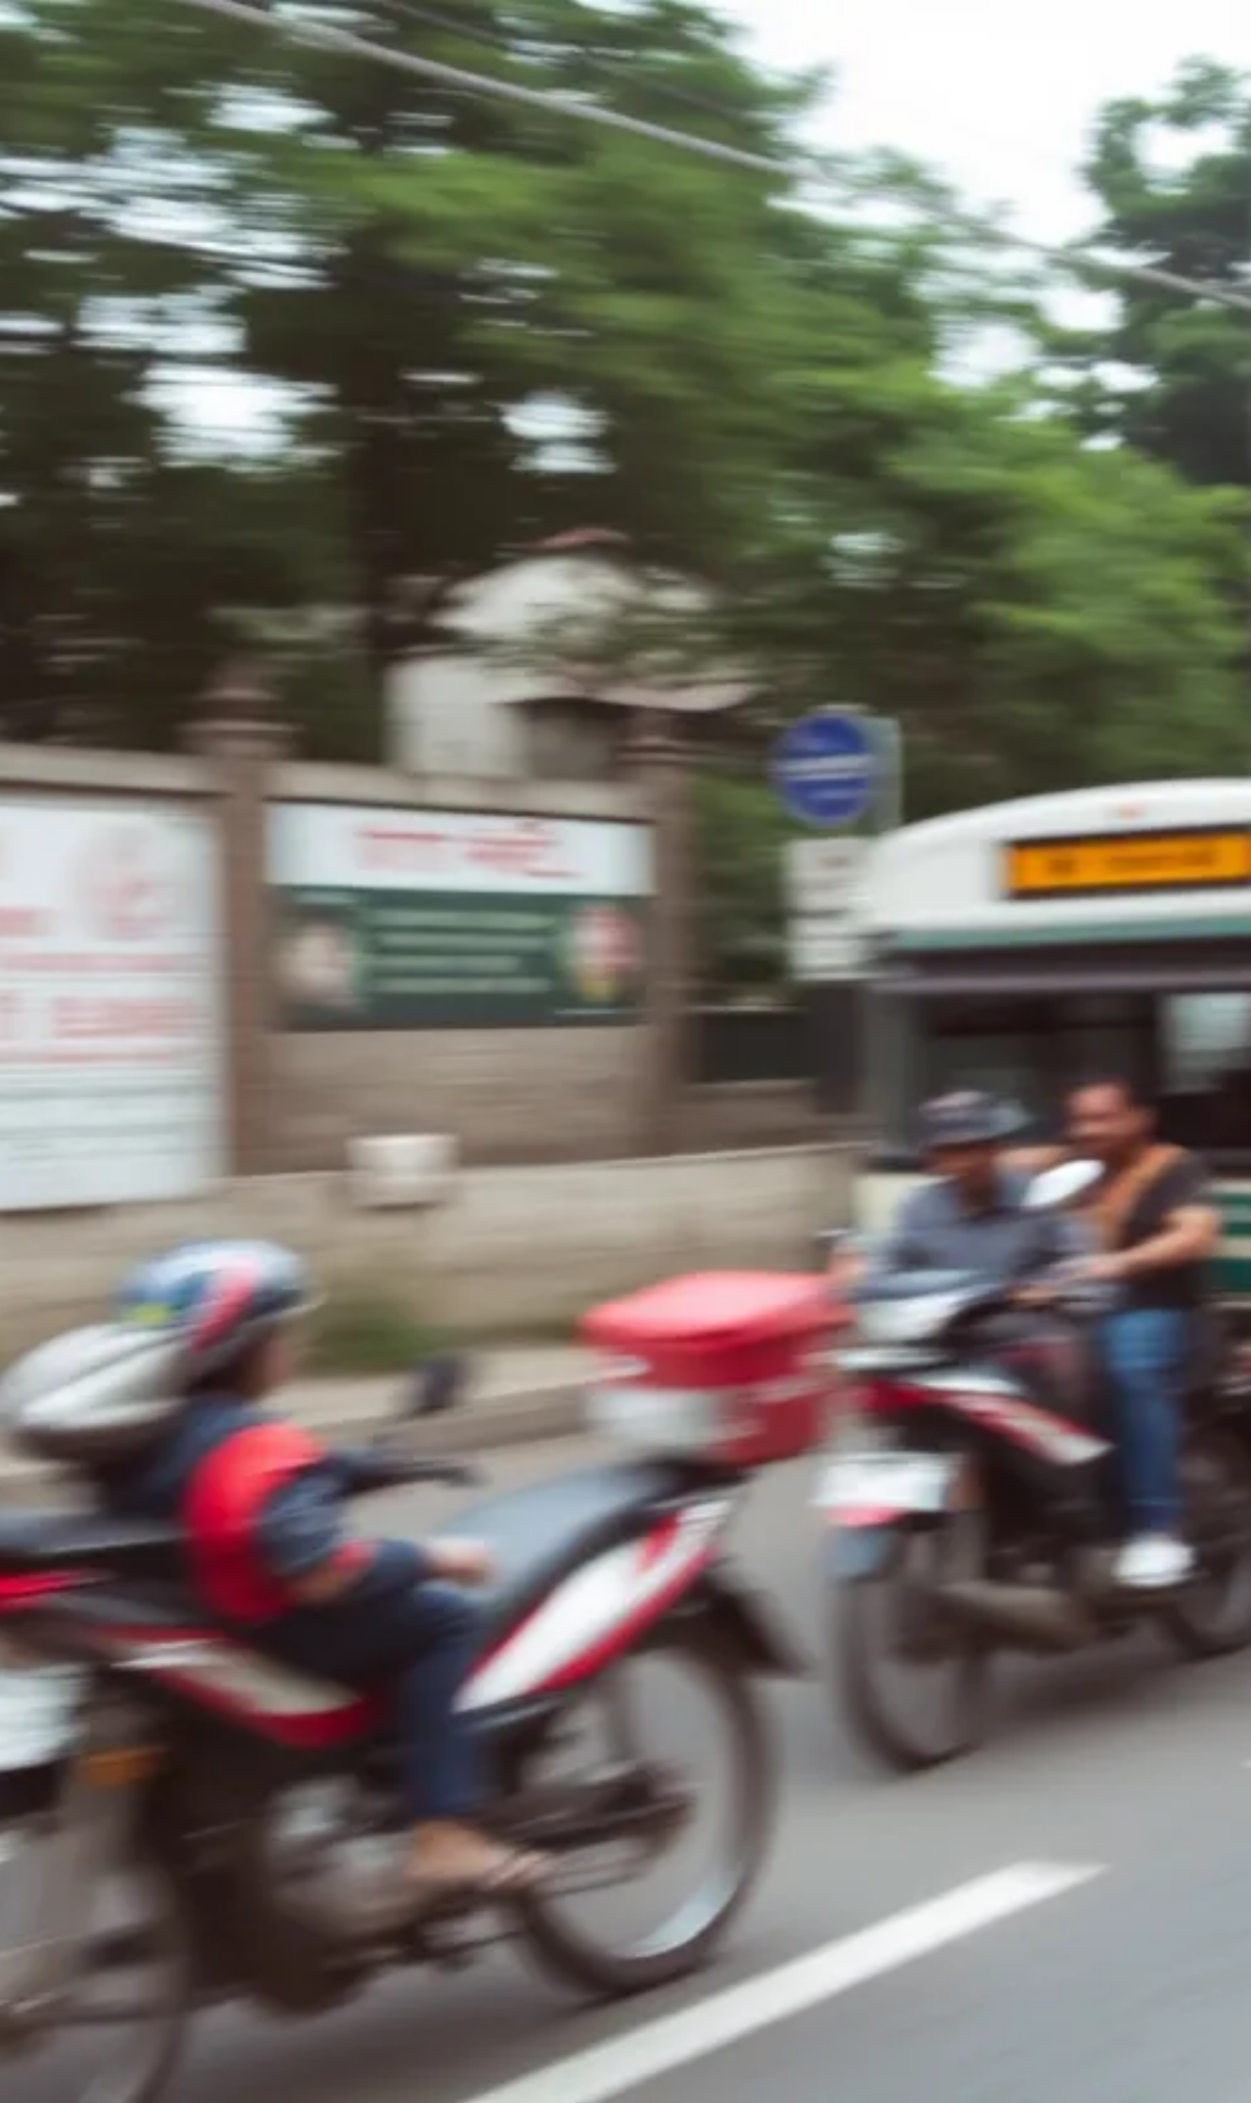

Samya Sewa Yatayat: Efficient Bus Booking System
Members:
Date: 2081.11.27
Sameer Sapkota
Shailesh Chaudhary
Sushant Thapa
Manish Pandey

Slide 2

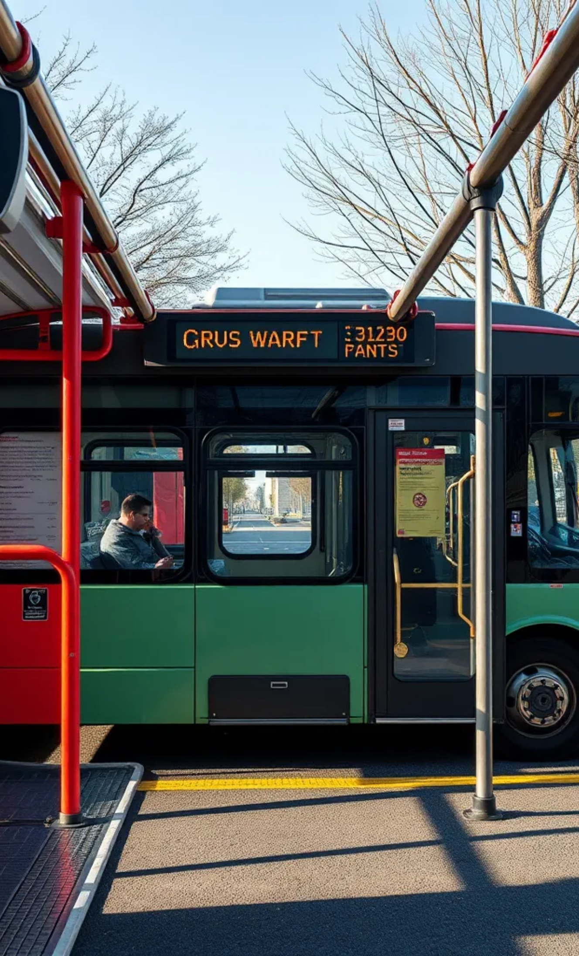

Overview
System Description
• Samya Sewa Yatayat is a digital bus seat booking system.
• Helps customers check bus details, book seats, and cancel bookings. Saves and loads booking data automatically.

Slide 3
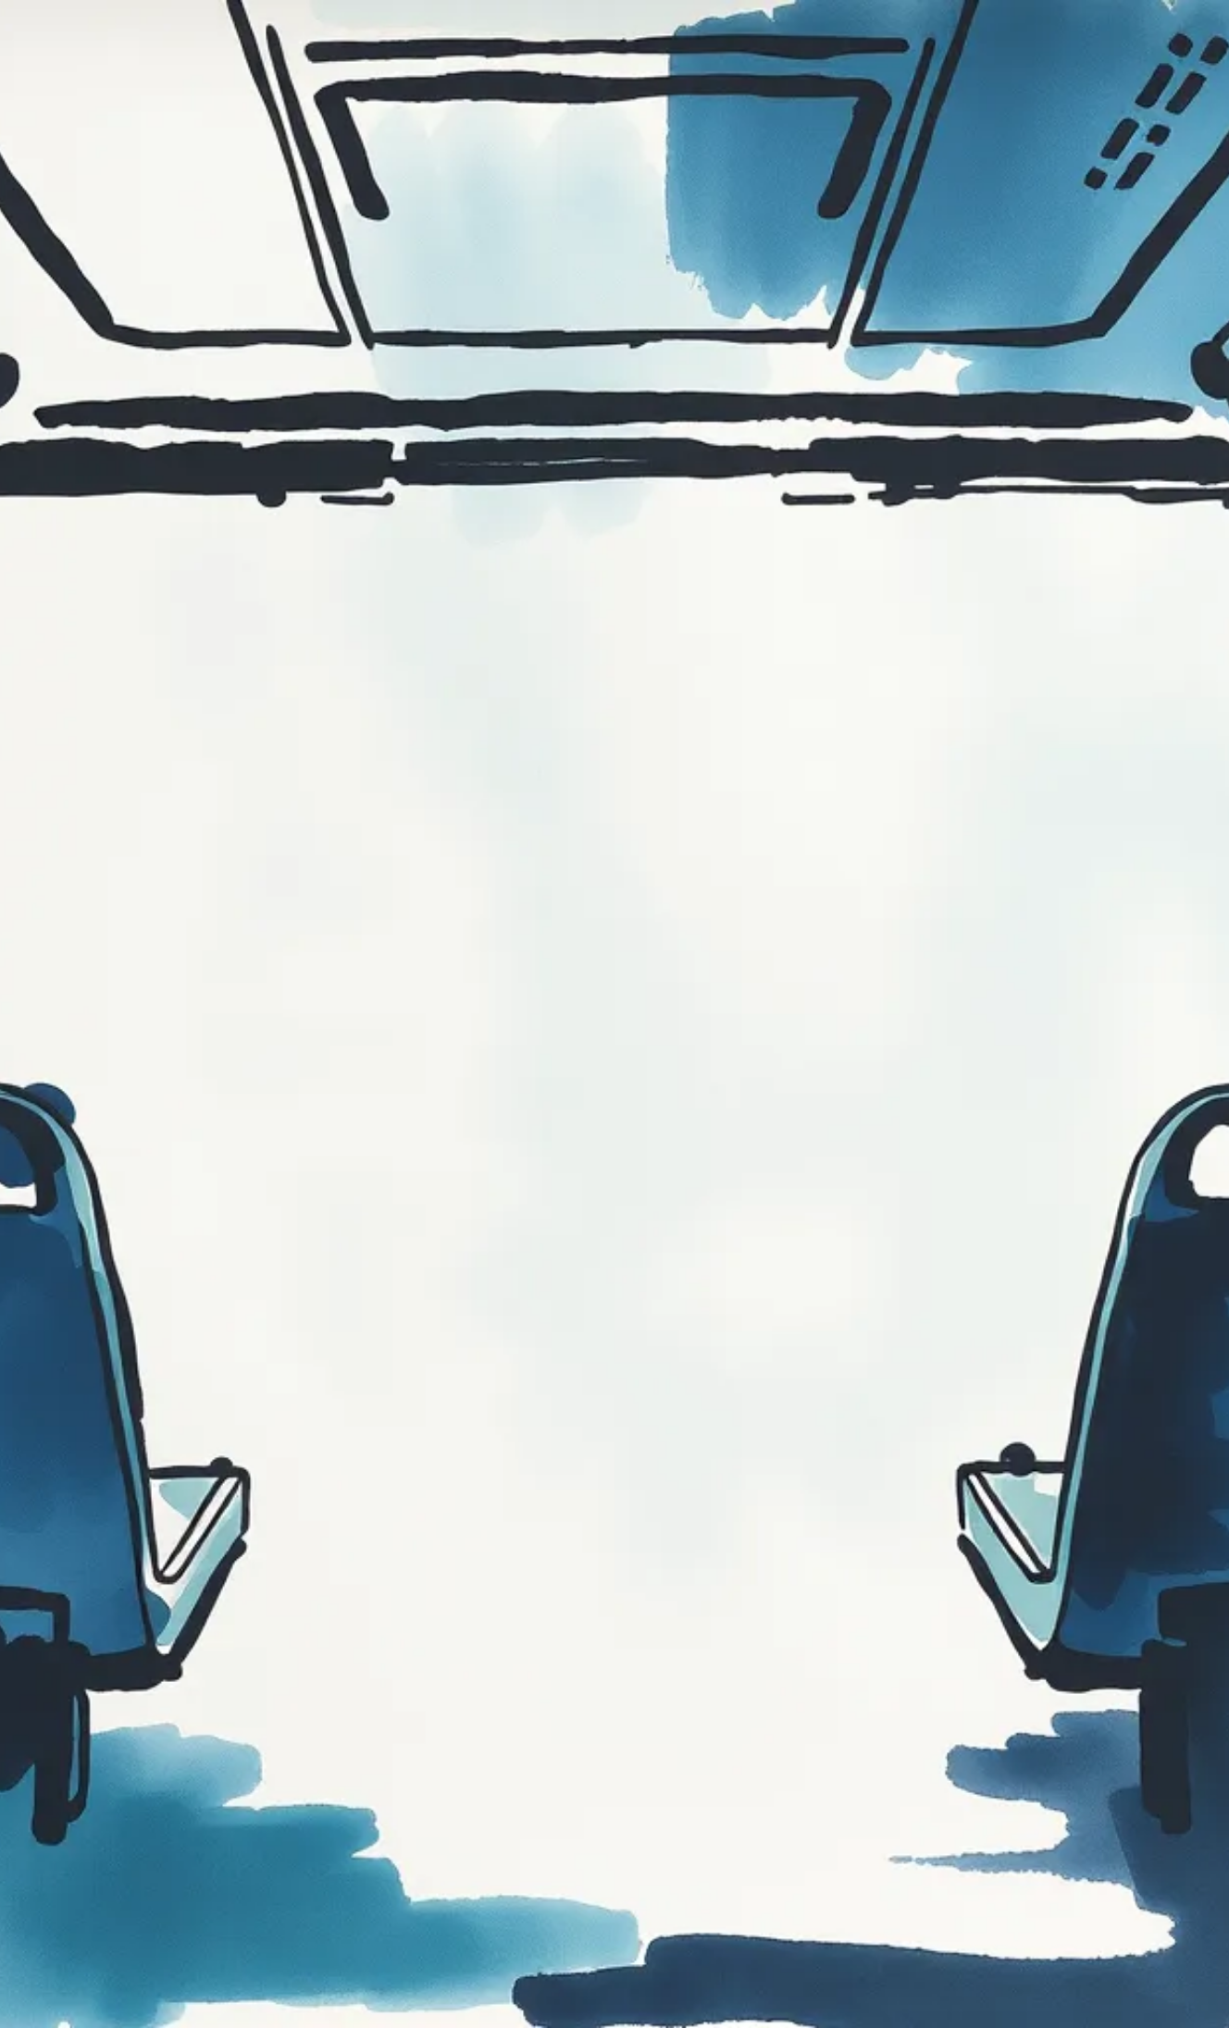
Key Features
• View bus details and fare information.
• Check seat availability in real-time.
• Book a seat with customer details.
• Cancel a booking when required
• Save and load booking data from a file

Slide 4
Flowchart
Process:
• User selects 'Book Seat'
• System asks for details (name, phone, age, seat number, destination)
• Checks seat availability
• If available, confirms booking & saves data
• If not available, prompts for another seat

Slide 5

🛠️ Technologies Used
🖥️ C Programming Language – Core language for the system. 📂 File Handling – Reads/writes booking data (travel.txt). 📊 Data Structures – 📌 Arrays → Seat availability tracking. 🗂 Structures (struct) → Stores booking details. 🔤 String Handling – Uses strcpy, strcmp, fgets, etc. ✅ Input Validation & Error Handling – Prevents invalid inputs.

Slide 6

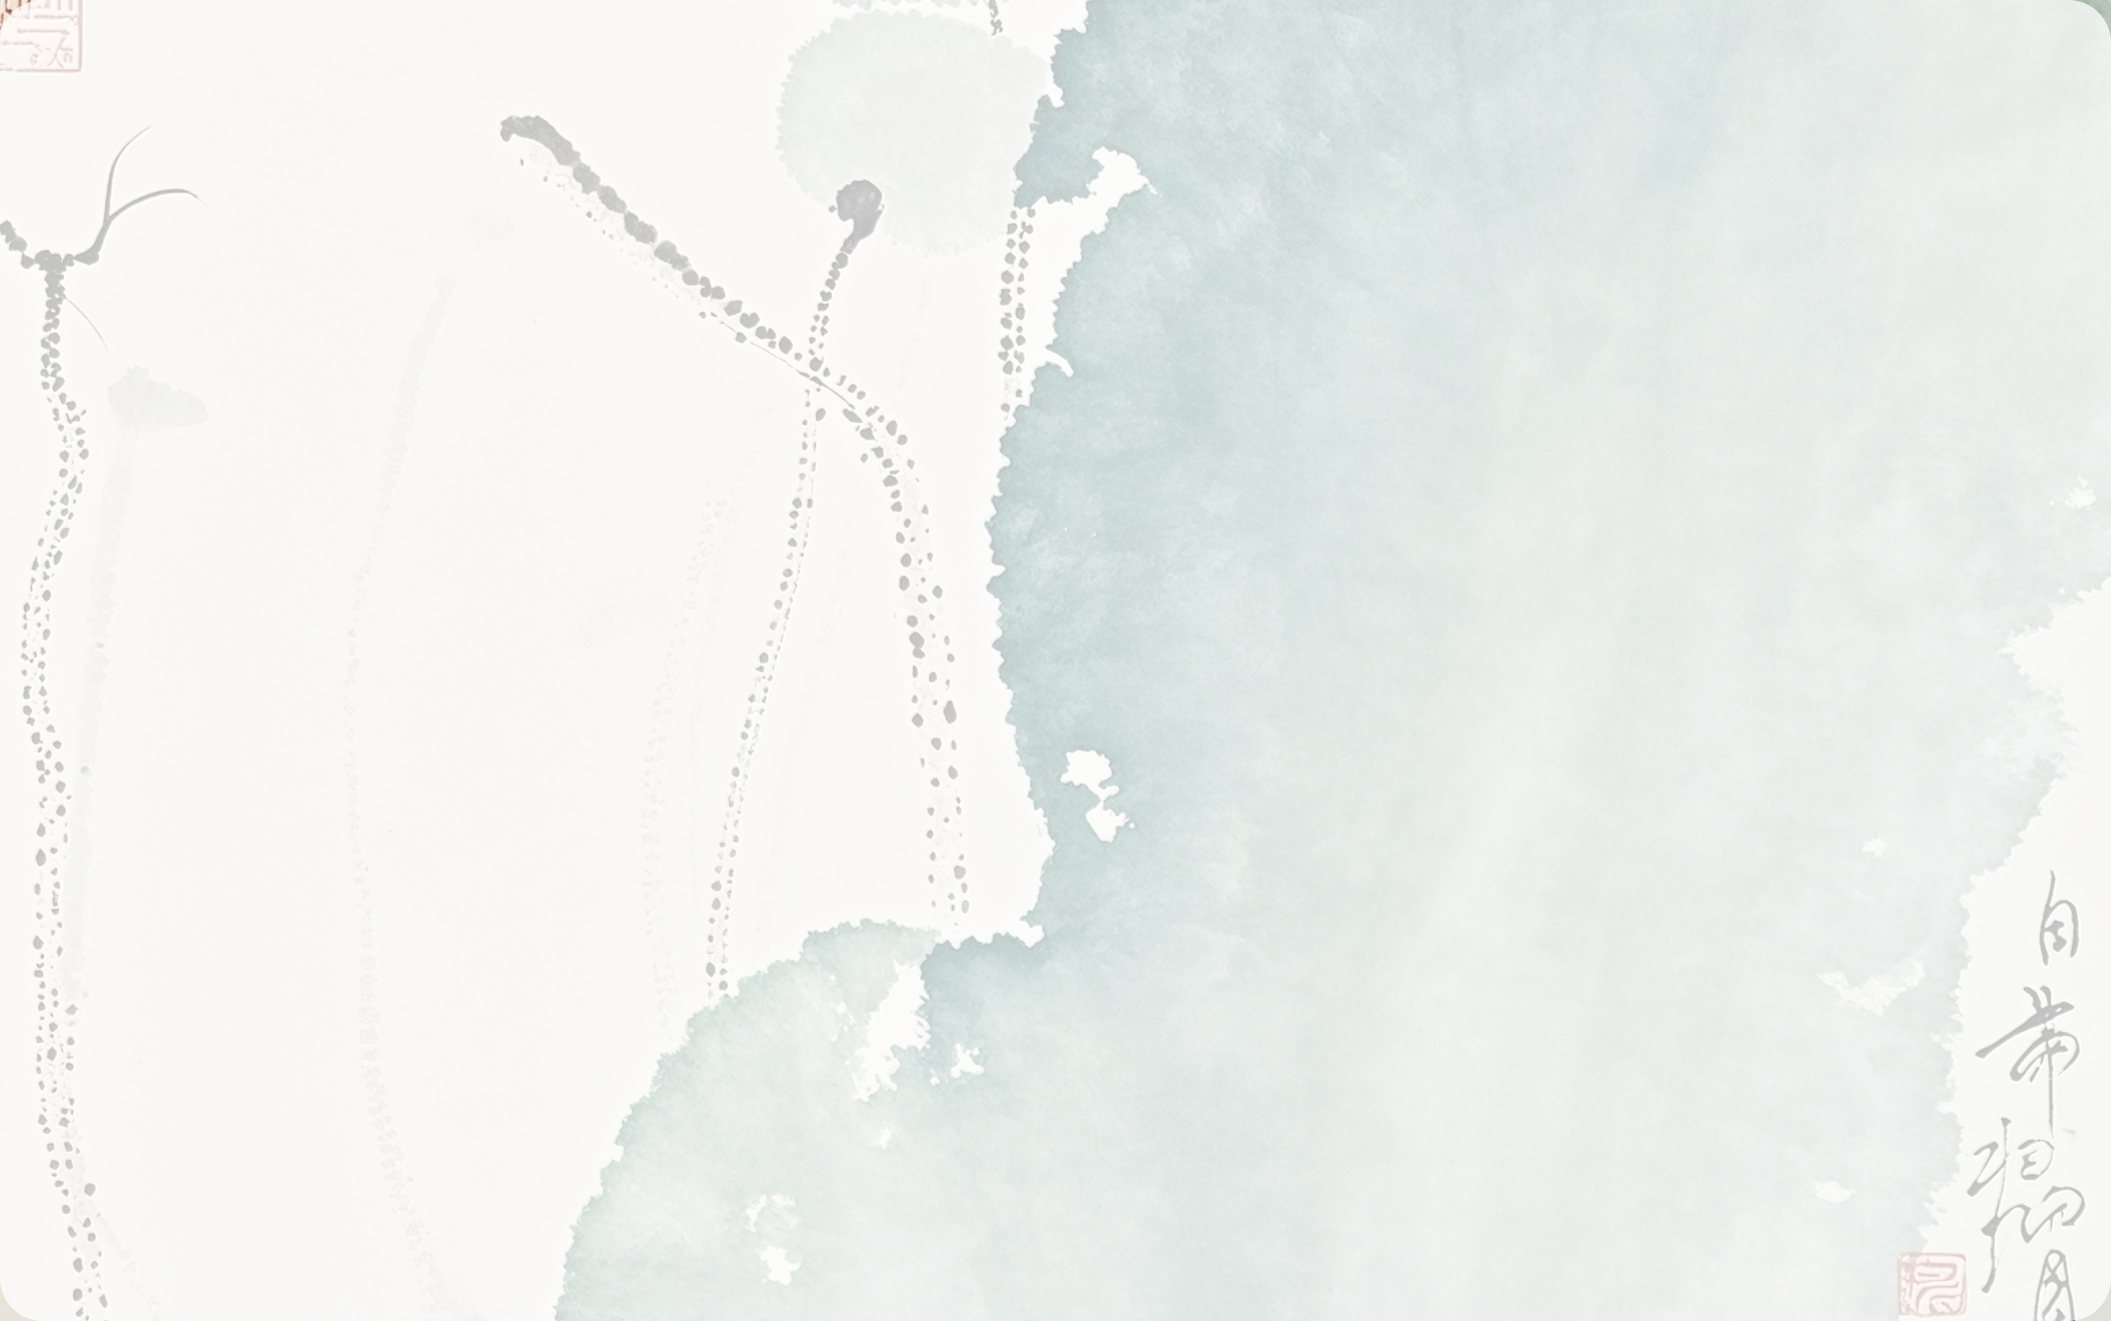

Seat Availability
Seat Number | Status (Booked/Available) | Passenger Name (if booked)
1 | Booked | samir
2 | Available | -
3 | Booked | samya

Slide 7
Advantages
System Benefits
• Efficient and quick seat booking.
• Avoids overbooking and seat duplication.
• Ensures data is saved for future reference.
• Simple and user-friendly interface.

Slide 8
Conclusion
Final Thoughts
• samya Sewa Yatayat simplifies the bus booking process.
• Ensures systematic booking management.
• Future improvements can make it more advanced.

